Slide 1

Wine quality regression project
Group 6
(Mech) Naved Patel 19070125057
(Mech) Harsh Jain 19070125031
(Mech) Ojeshwar Sharma 19070125055
(CS) Shantanu Bhattacharya 20070122515

Slide 2
Information about datasets
This datasets is related to red and white variants of the Portuguese "Vinho Verde" wine. The dataset describes the amount of various chemicals present in wine and their effect on it’s quality. The datasets can be viewed as classification or regression tasks.

Slide 3
What Dataset Did We Choose?
For our data set we decided to go with the red and white wine datasets from the UCI website.
The reason we picked this dataset was because of the fairly limited number of attributes that allowed us to focus more on the models.
We have choose this dataset because it is publicly used for research.

Slide 4
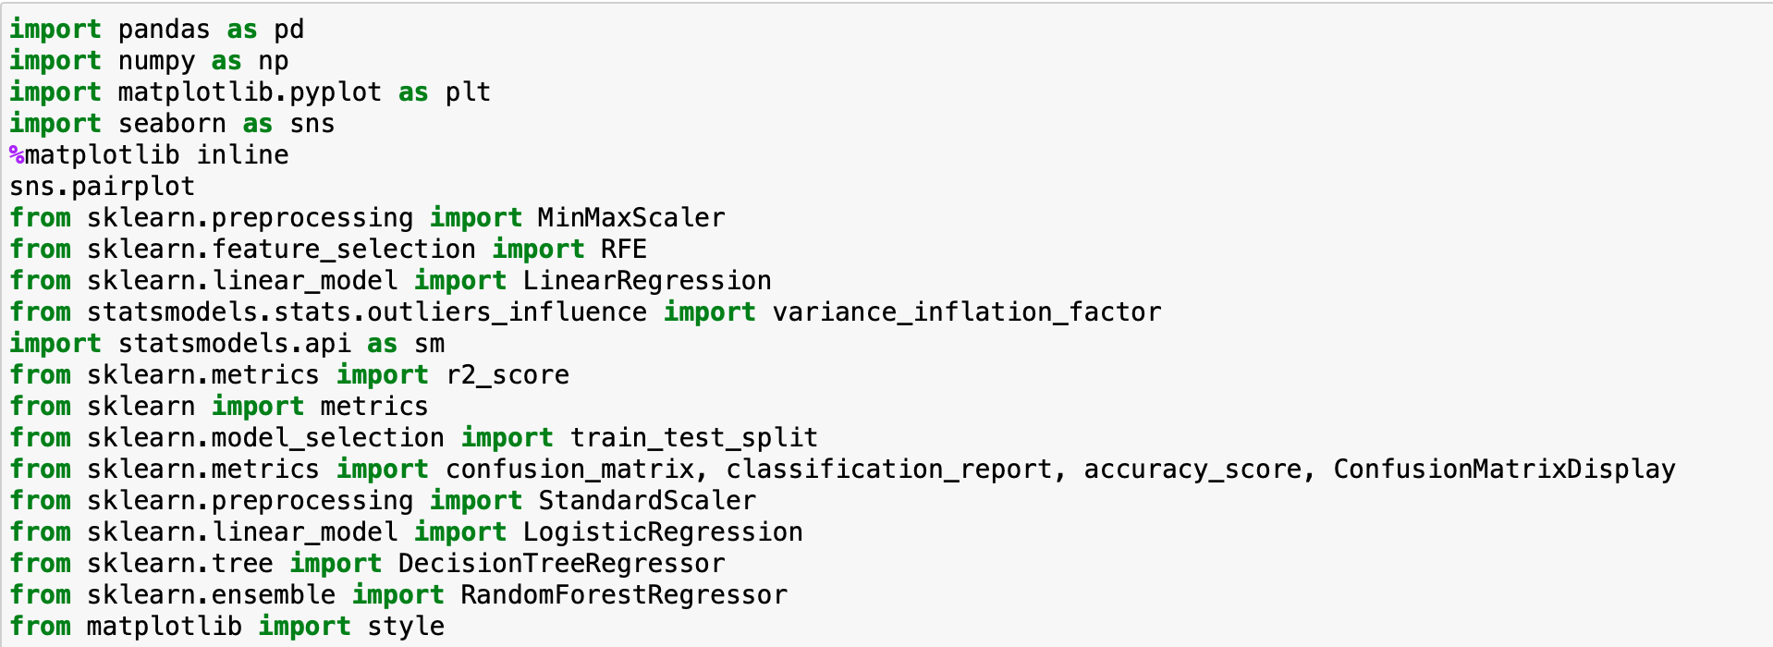
Library used

Slide 5
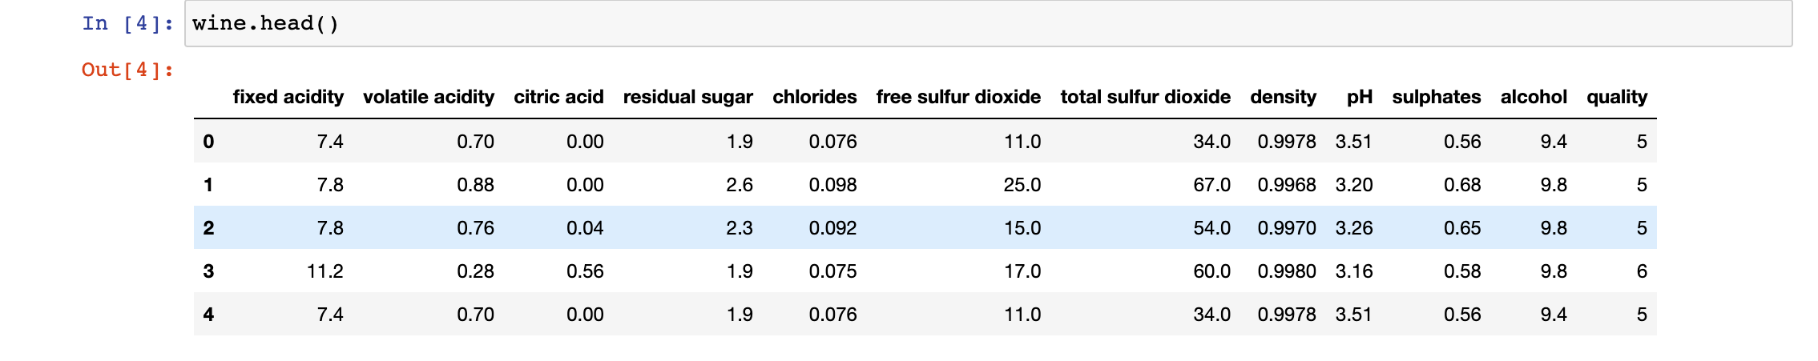
Red wine regression dataset

Slide 6
White wine regression dataset

Slide 7
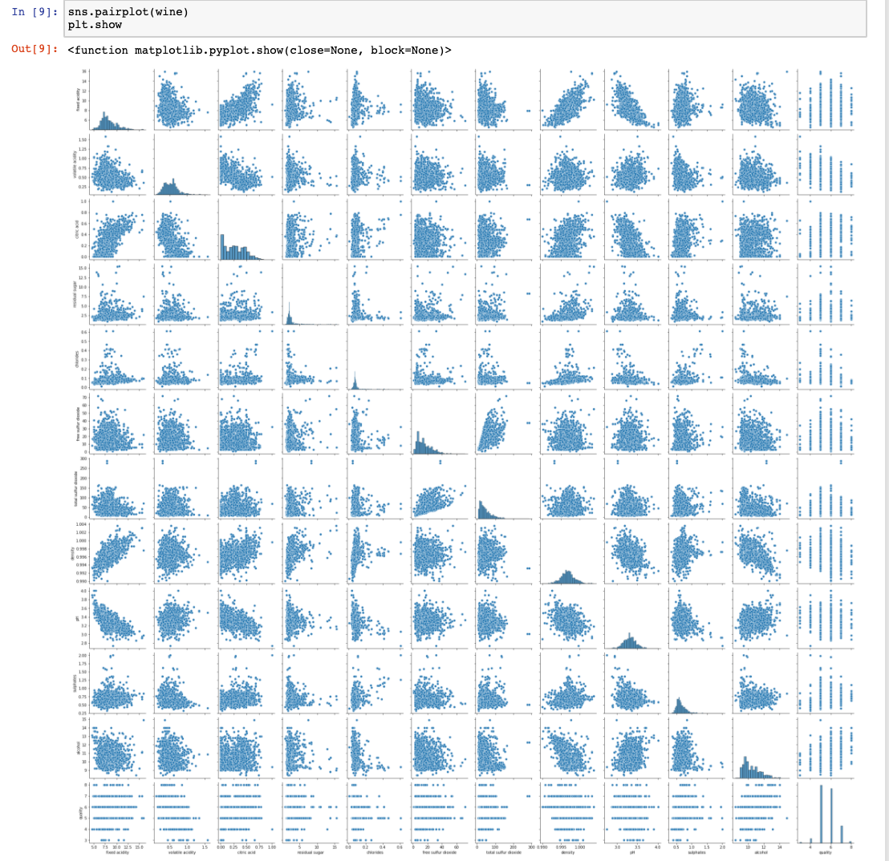
Scatter Matrix For Red Wine Dataset

Slide 8
Scatter Matrix For white Wine Dataset

Slide 9
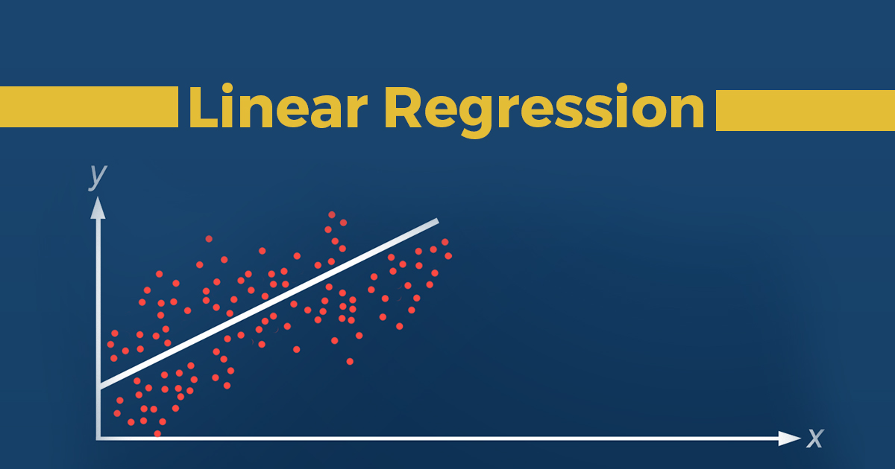
Linear regression
Linear Regression is a machine learning algorithm based on supervised learning. Linear regression performs the task to predict a dependent variable value (y) based on a given independent variable (x). So, this regression technique finds out a linear relationship between x (input) and y(output).

Slide 10
Linear regression for red wine dataset

Slide 11
Linear regression for white wine dataset

Slide 12
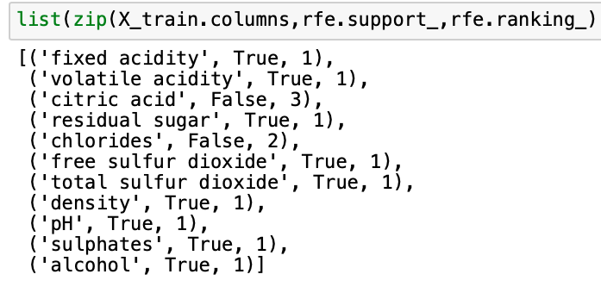
Linear regression

Slide 13
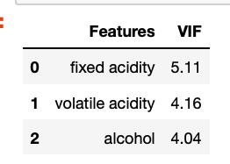
Final prediction attributes

Slide 14
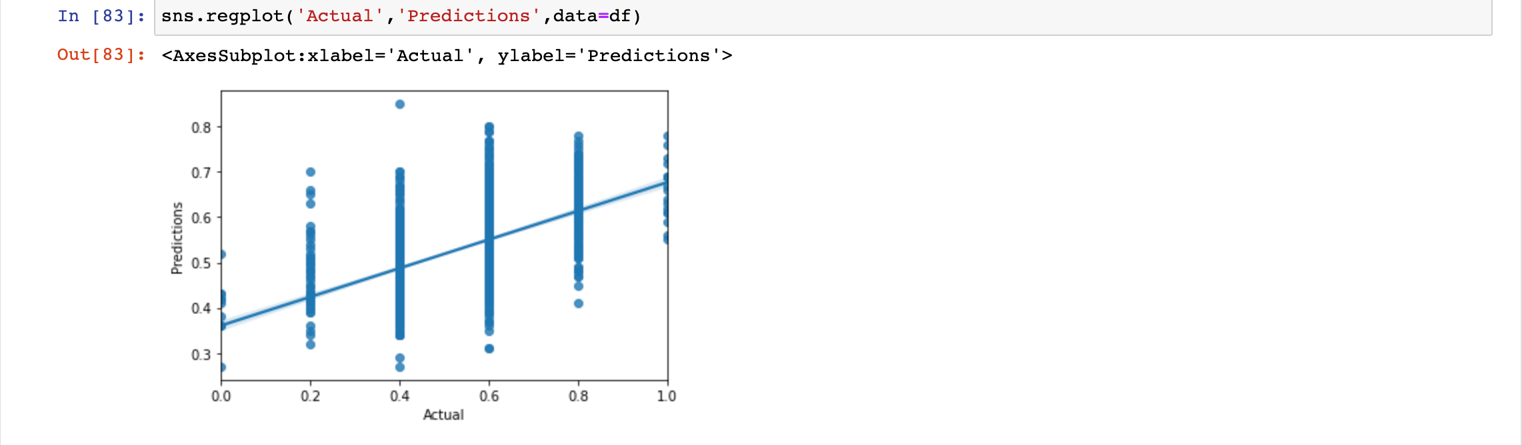
Prediction for red wine

Slide 15
Prediction for white wine

Slide 16
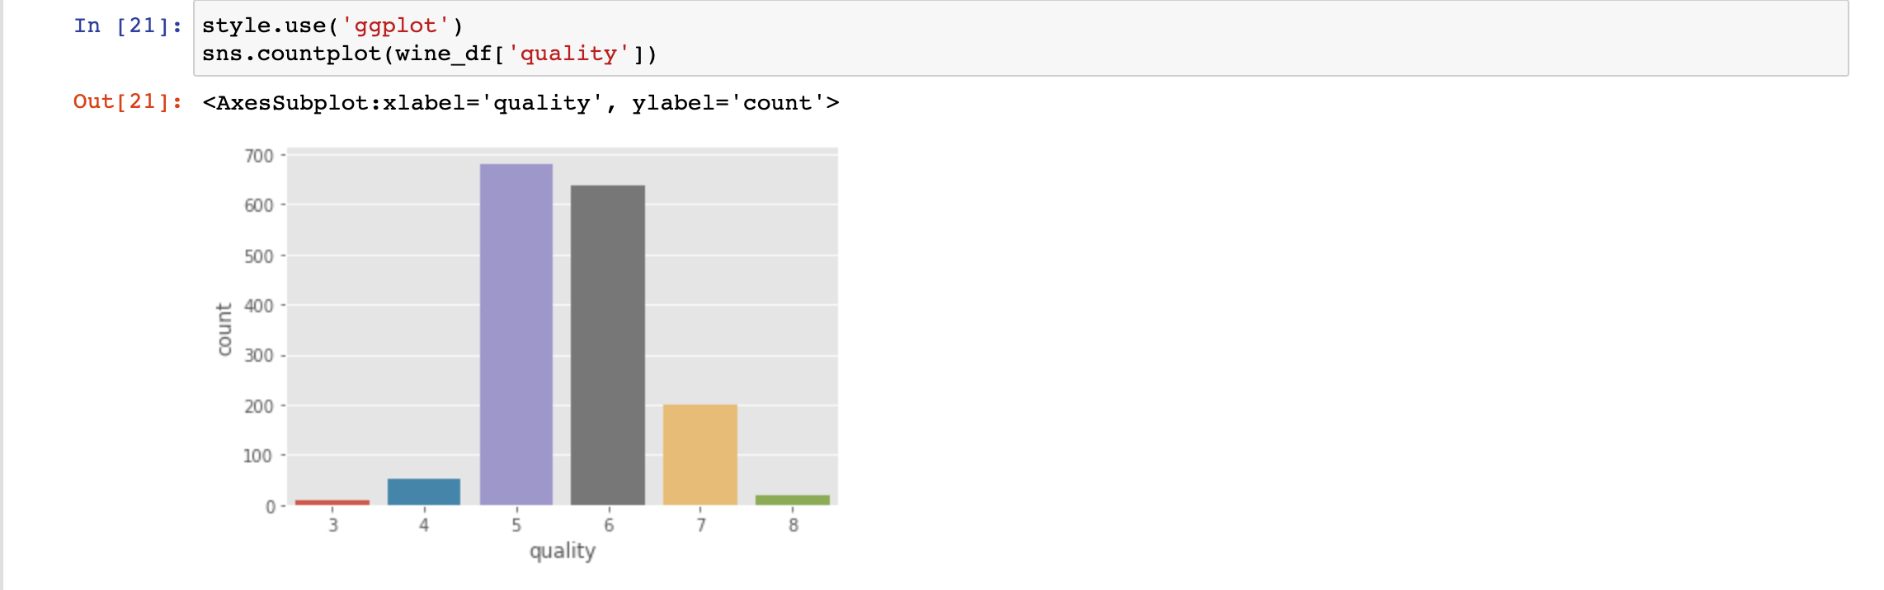
Histogram for red wine

Slide 17
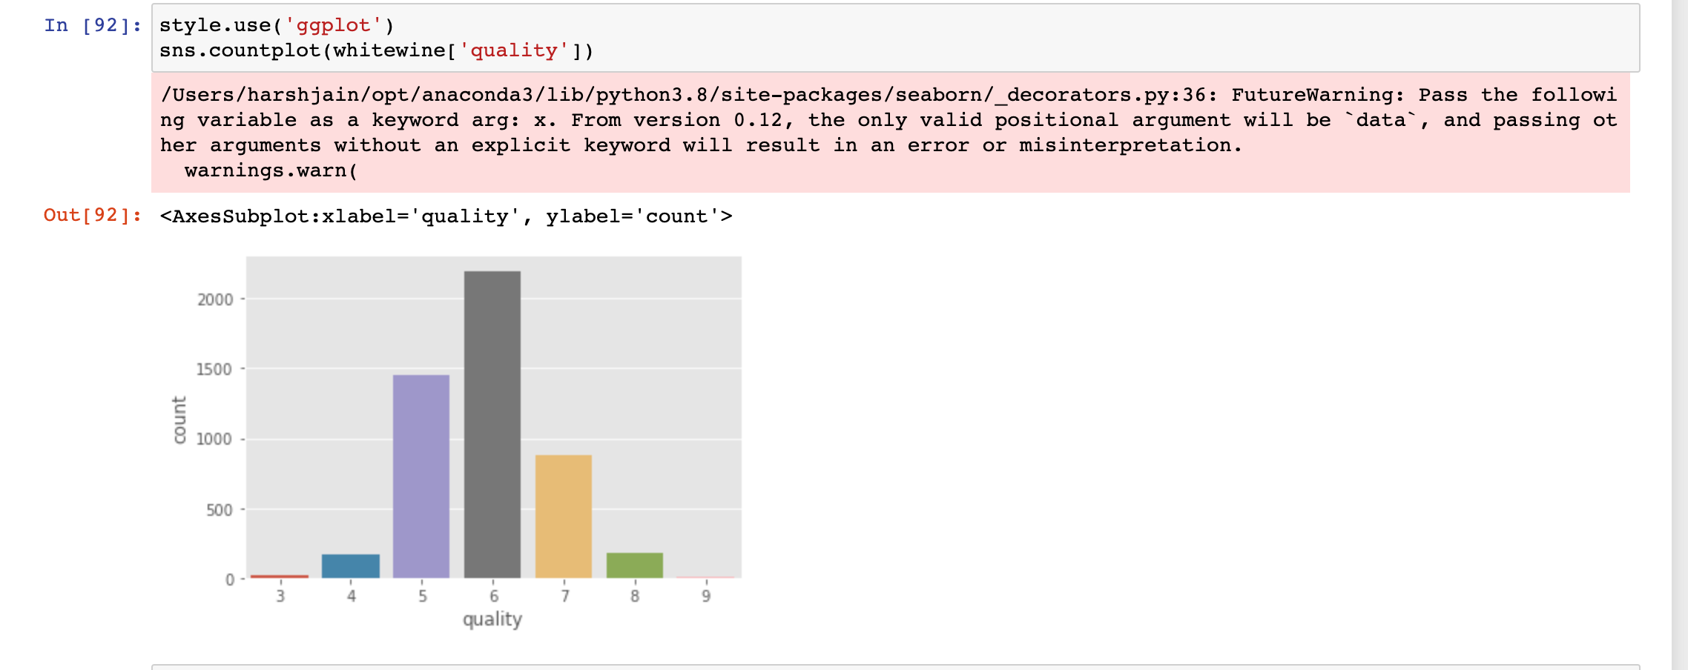
Histogram for white wine

Slide 18
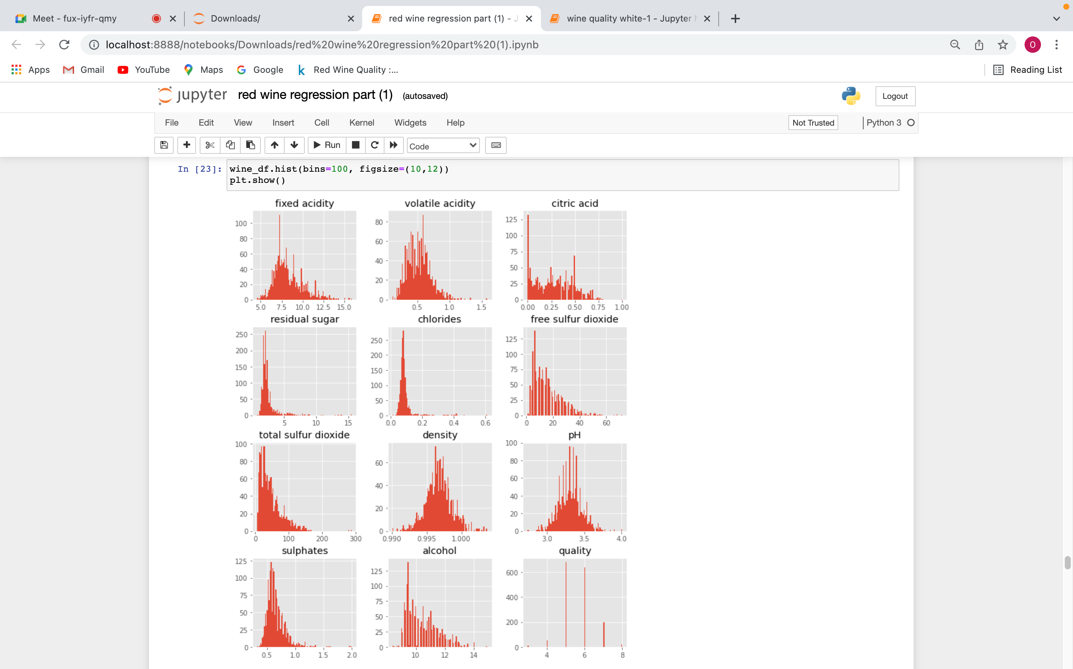
For all 8 attributes for red wine

Slide 19
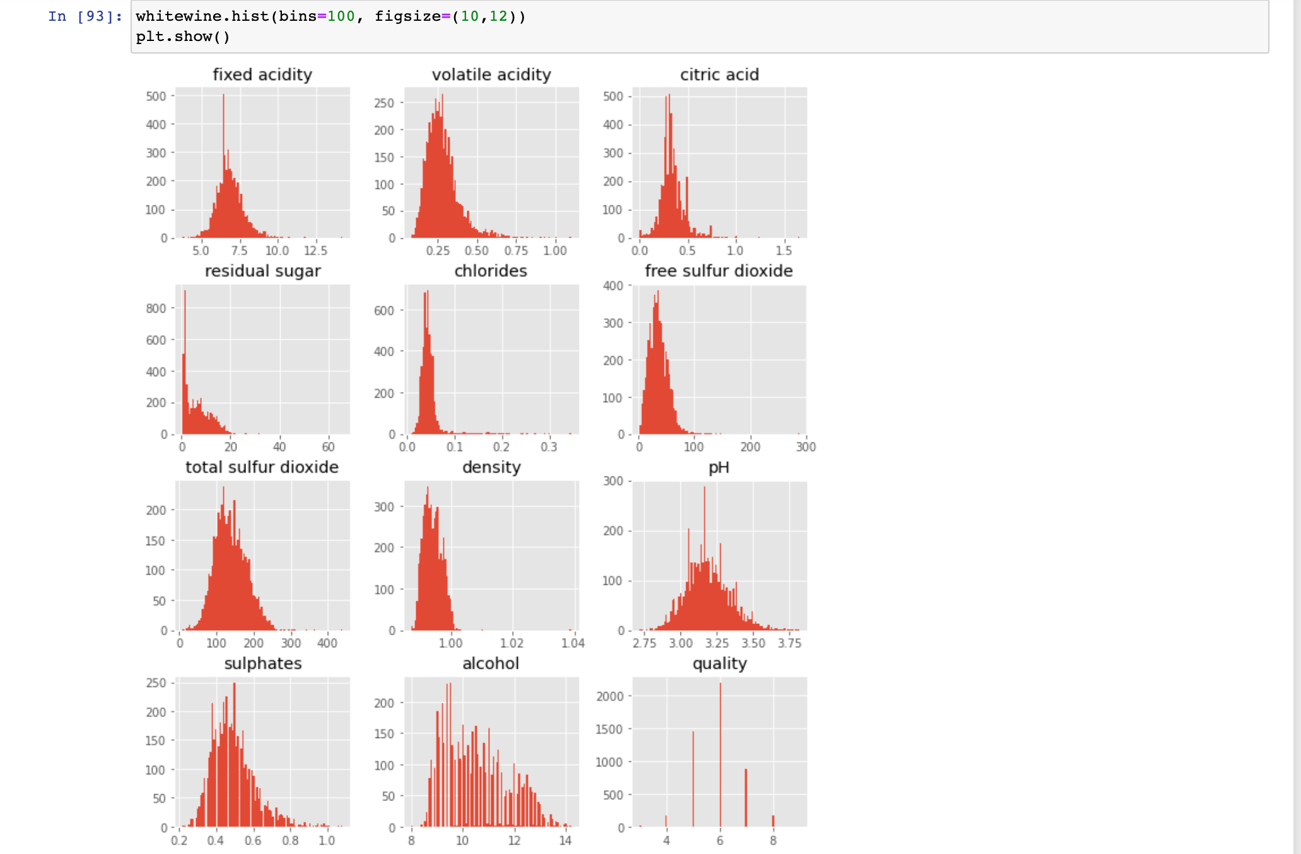
For all 8 attributes for white wine

Slide 20
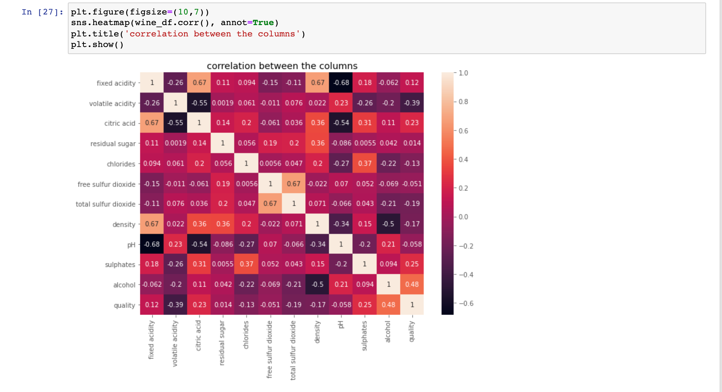

Slide 21
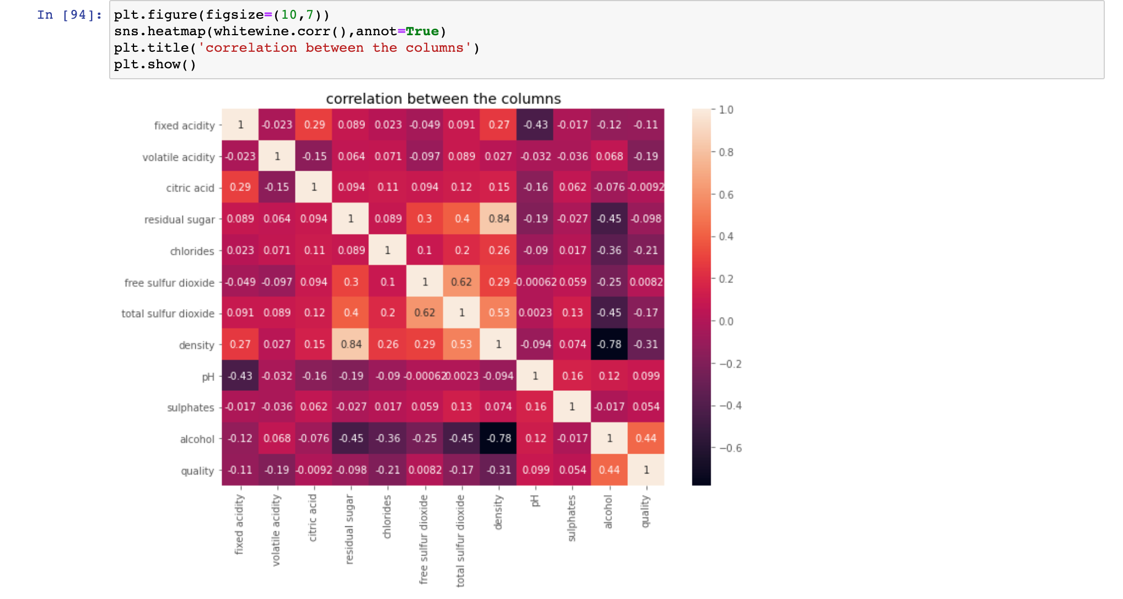

Slide 22
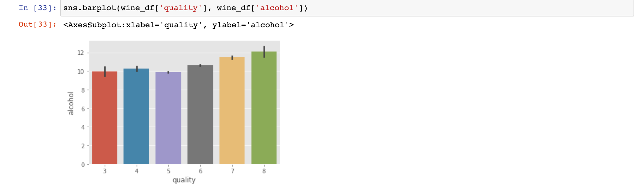

Slide 23
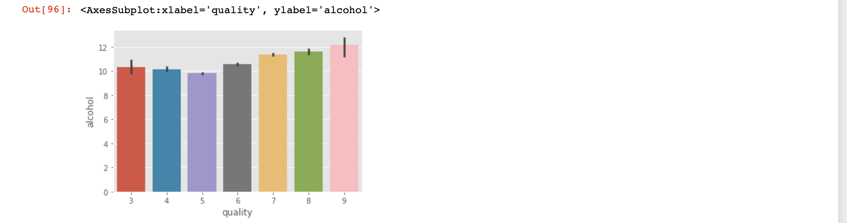

Slide 24
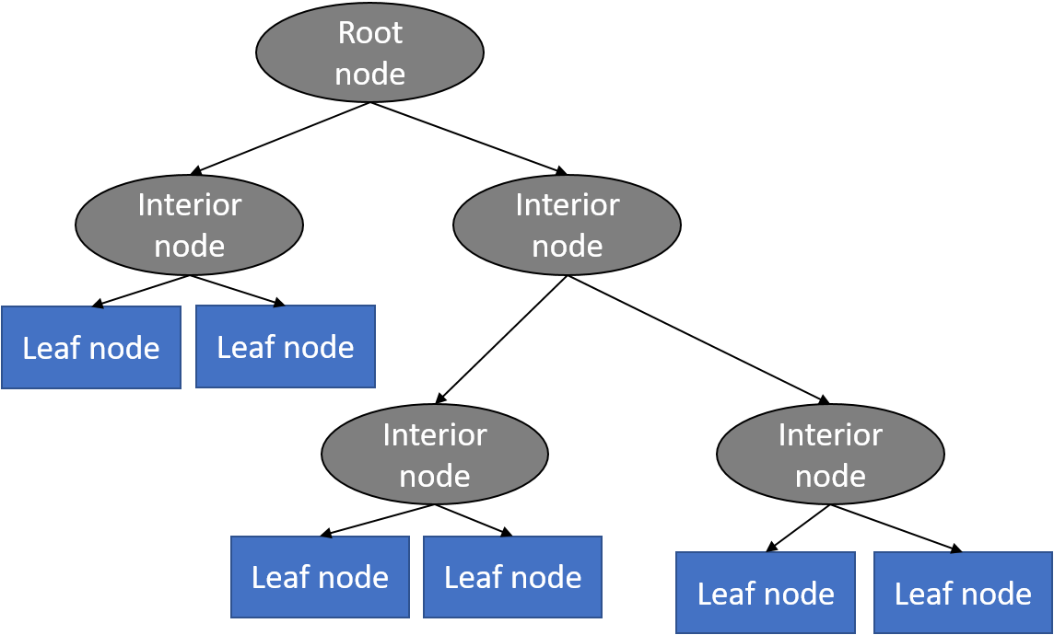
Decision Tree is one of the most commonly used, practical approaches for supervised learning. It can be used to solve both Regression and Classification tasks with the latter being put more into practical application. It is a tree-structured classifier with three types of nodes. The Root Node is the initial node which represents the entire sample and may get split further into further nodes. The Interior Nodes represent the features of a data set and the branches represent the decision rules. Finally, the Leaf Nodes represent the outcome. This algorithm is very useful for solving decision-related problems.
DECISION TREE

Slide 25
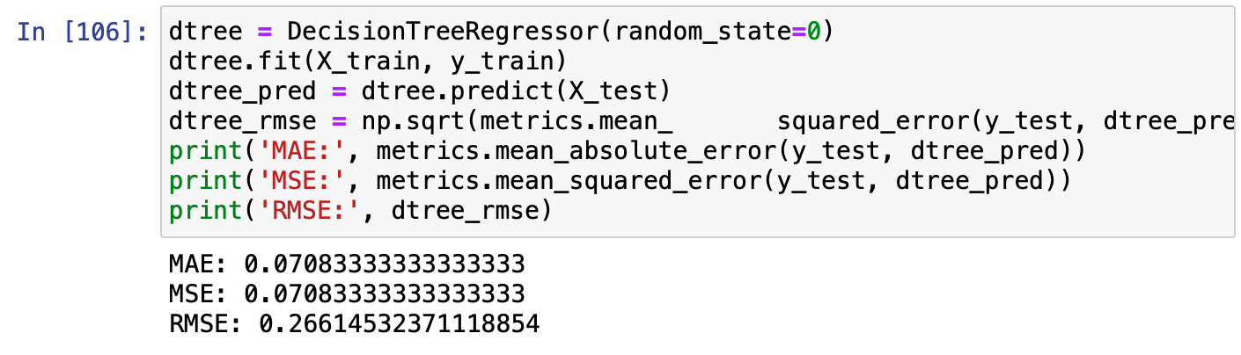
implementation of dtree in red wine

Slide 26
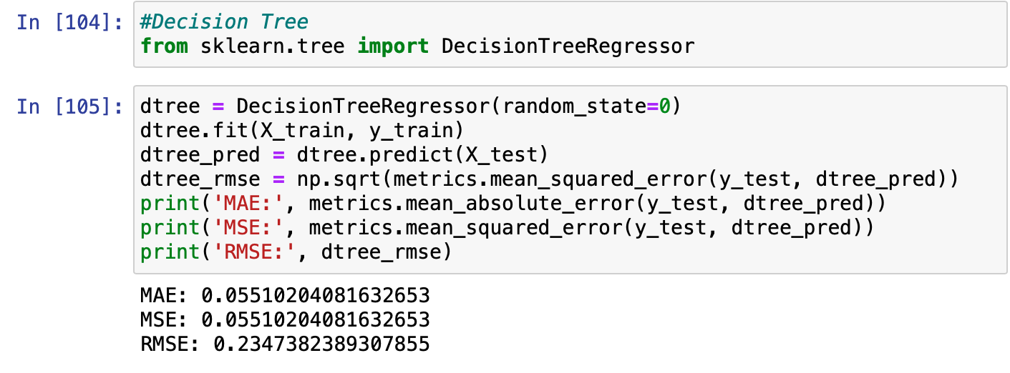
Implementation of dtree in white wine

Slide 27
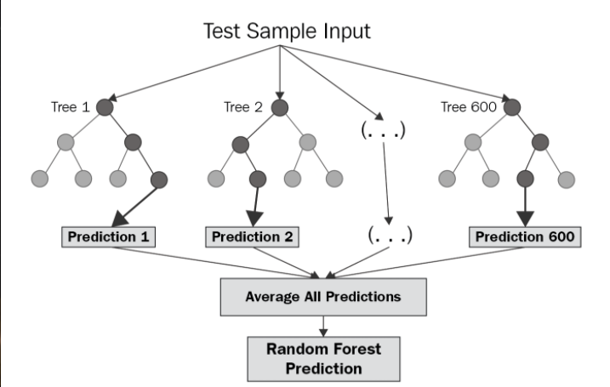
Random forests or random decision forests are an assembly learning method for classification, regression and other tasks that operates by constructing a multitude of decision tree at training time. For classification tasks, the out put of the random forest is the class selected by most trees. For regression tasks, the mean or average prediction of the individual trees is returned. Random decision forests correct for decision trees' habit of overfitting to their training set. Random forests generally outperform decision tree, but their accuracy is lower than gradient boosted trees. However, data characteristics can affect their performance.
Random Forest

Slide 28
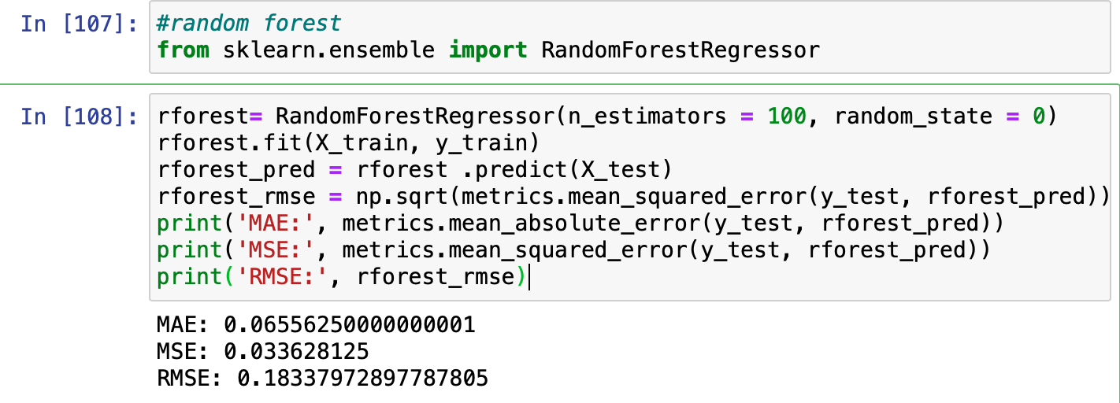
Implementation of random forest in red wine

Slide 29
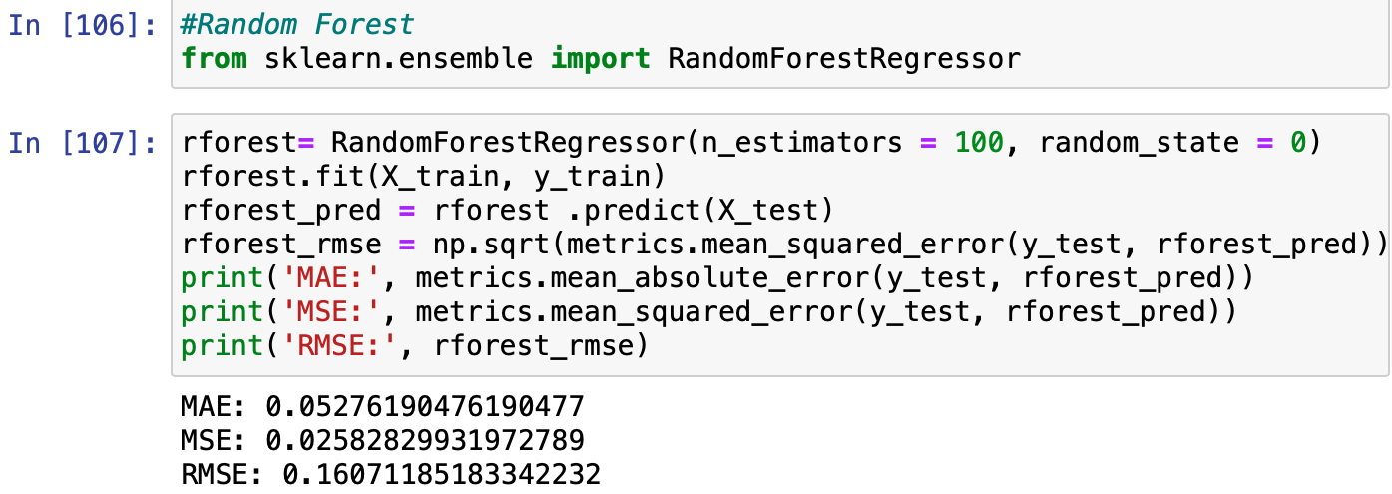
Implementation of random forest in white wine

Slide 30
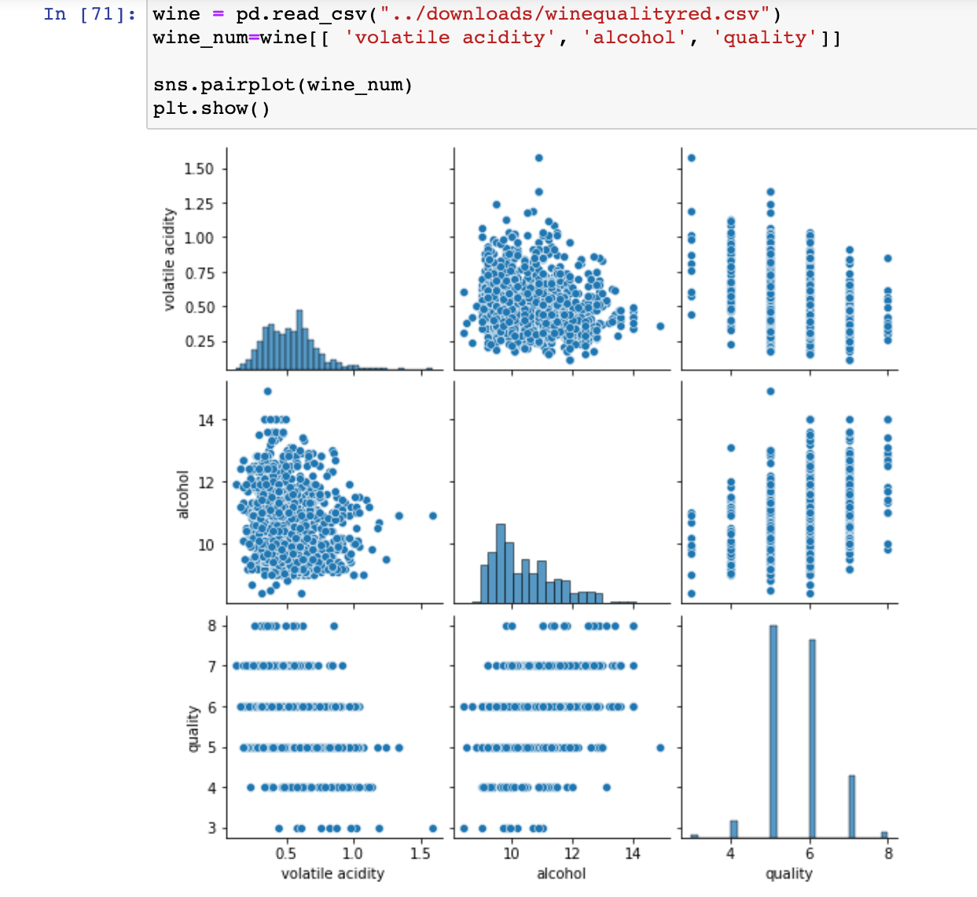
Table for red wine

Slide 31
Table foe white wine

Slide 32
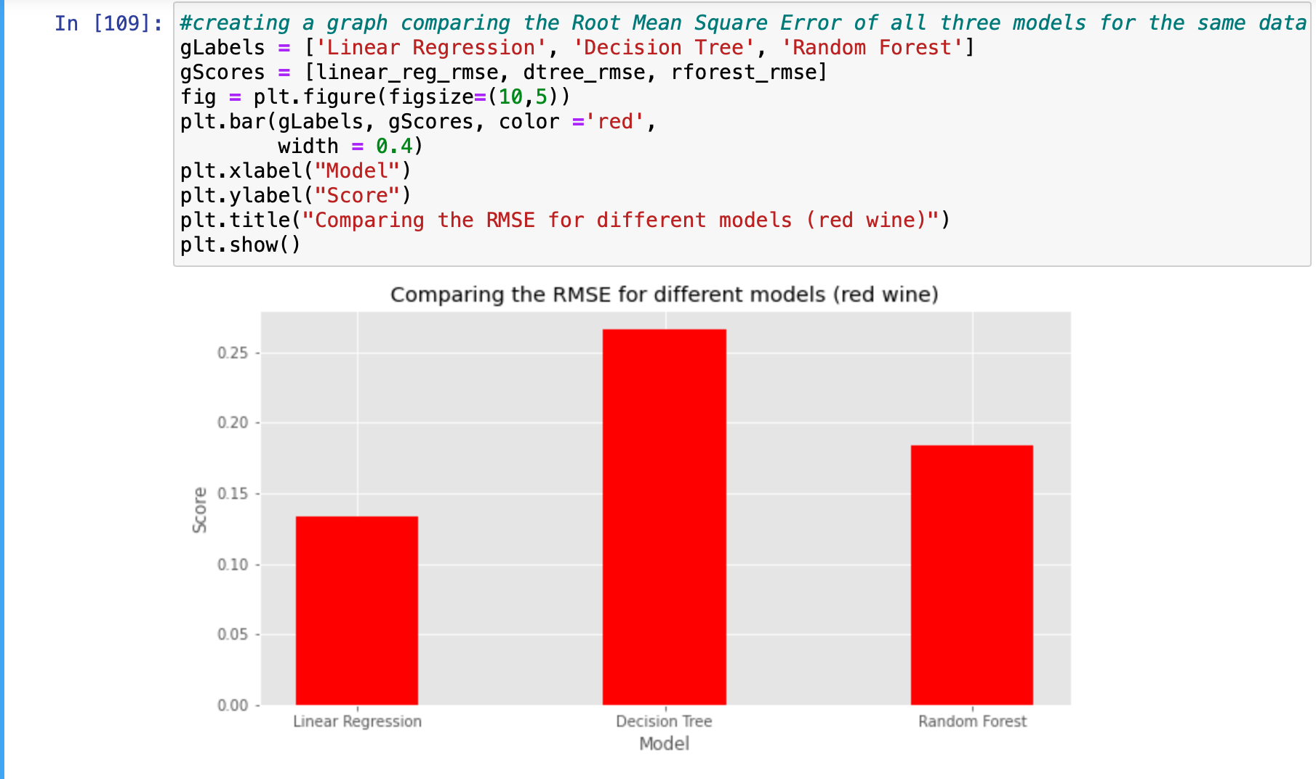
RMSE GRAPH for red wine

Slide 33
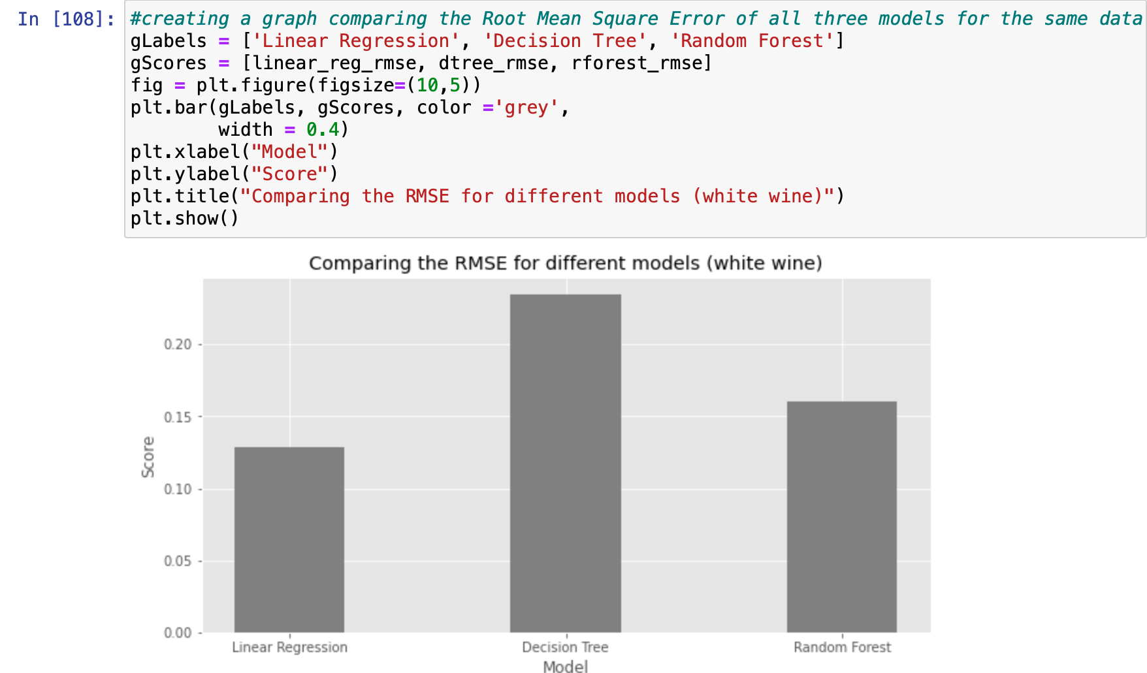
RMSE graph of white wine

Slide 34
Conclusion
We Have implemented three algorithm which are linear regeression, decision tree, and random forest.in which prediction result shows that the least RMSE value which was linear regression which gives the best prediction result among all three algorithm.

Slide 35
references
1.Red wine quality predicition.datascience
https://towardsdatascience.com/red-wine-quality-prediction-using-regression-modeling-and-machine-learning-7a3e2c3e1f46
2. Ibm. Linear regression .info
https://www.google.co.in/url?sa=t&rct=j&q=&esrc=s&source=web&cd=&cad=rja&uact=8&ved=2ahUKEwiWkqWUsJz0AhWPzzgGHT4KBdMQFnoECAIQAQ&url=https%3A%2F%2Fwww.ibm.com%2Ftopics%2Flinear-regression&usg=AOvVaw167AB_1YBg-wQxmnzVztwC
3.Linear regression.Wikipedia.info
https://www.google.co.in/url?sa=t&rct=j&q=&esrc=s&source=web&cd=&cad=rja&uact=8&ved=2ahUKEwjw7fCarpz0AhWSX3wKHQdABPgQFnoECCAQAQ&url=https%3A%2F%2Fen.wikipedia.org%2Fwiki%2FSimple_linear_regression&usg=AOvVaw0KEB28NbXL_KbWkDXfD6t6
4.Random forest.wikipeda.info
https://www.google.co.in/url?sa=t&rct=j&q=&esrc=s&source=web&cd=&cad=rja&uact=8&ved=2ahUKEwjQwZa_rpz0AhVs73MBHaQTBZEQFnoECAQQAQ&url=https%3A%2F%2Fen.wikipedia.org%2Fwiki%2FRandom_forest&usg=AOvVaw0H4kXRhWcf28po9b-MQHFV
5.Decision tree .Wikipedia.info
https://www.google.co.in/url?sa=t&rct=j&q=&esrc=s&source=web&cd=&cad=rja&uact=8&ved=2ahUKEwjsgu_Yrpz0AhVY83MBHdi0A90QFnoECCEQAQ&url=https%3A%2F%2Fen.wikipedia.org%2Fwiki%2FDecision_tree_learning&usg=AOvVaw0jcMwyitzNg39AFNH0r5SA

Slide 36
Thank you

